Slide 1
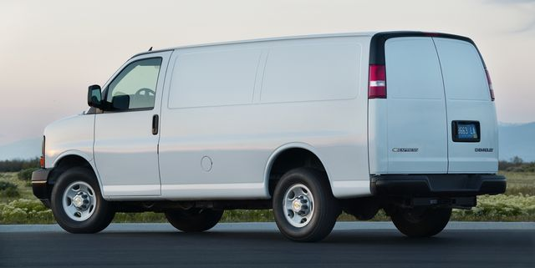
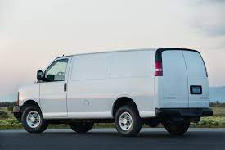

Delivery Management System
Team – Uche Muhamed Jabaran

Slide 2
“If you want to stand out, try something different”
- Chris Yiangou

Slide 3
Our approach
We approached the project quite differently to challenge ourselves and implement features to create a robust system.
We believe that using Python was the best choice for this project as it is easy to use and good for the scope.

